Slide 1

The Technology Value Stream 1/9/2022 Oksana kustova

Slide 2

The Technology Value Stream
Definition
The technology value stream is the process required to convert a business hypothesis into a technology-enabled service that delivers value to the customer. That process includes product management, development, quality assurance, IT operations, and information security.

Slide 3
Lead Time vs Processing time
Lead time measures the time elapsed from the point a piece of work – such as defect or feature – is requested (usually by a customer) to the point that it’s delivered.
Flow time, on the other hand, measures the time it takes for a work item to go from the point that it is accepted into the value stream – i.e., from its first “active state” – to when it’s available to the customer (deployed or delivered).
Definitions

Slide 4
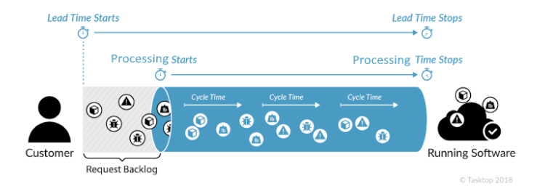
Lead Time vs Processing time

Slide 5
Lead Time vs Processing time
Processing time is a better representation of business value. While lead time is an interesting measure from a customer perspective, and teams have derived a lot of insights on speed in delivery by measuring and reporting on it, processing time is more valuable from a business perspective.
Conclusion

Slide 6
Deployment Lead Timers Requiring Months
Lead time as a measurement of efficiency is something which can vary widely across organizations depending on factors such as team size, the skill, and the workload of each developer. It’s not about using it simply to measure the work of individual team members - it would be unreasonable for a team of junior developers to achieve the elite metrics of very experienced developers.
Example

Slide 7
Deployment Lead Timers Requiring Months
Mik Kersten, in his book Project to Product, talks about opensource projects that have a myriad of feature requests spread across a small number of developers. This means that some requests can sit in the backlog for long periods before work is ever started on them, elongating lead time (and time to value).
Example

Slide 8
Deployment Lead Times of Minutes
A long lead time means the risk that your efforts at leading-edge innovation may not be all that new or exciting by the time they reach the customer, and faster-moving competitors may have usurped you.
With Continuous Delivery, you can release each feature as it is ready rather than waiting for an 'all-in' big release, substantially reducing lead time. A chain of smaller releases keeps customers happy and faster; smaller releases make it easy for developers to modify their work in response to customer feedback.
Strive for the ideal

Slide 9

Conclusion
Reducing lead time is critical but equally important are the metrics of deployment frequency, mean time to restore (MTTR), and change failure percentage. One of the benefits of DevOps is that it's a way of thinking rather than prescriptive steps or practices. This means it's malleable and adaptable to specific organizational culture, processes, challenges and goals. DevOps enables an organization to forward their goals and increase their quality of product and customer service.

Slide 10
References
Kim, G., Humble, J., Debois, P., & Willis, J. (2016). The devops handbook how to create world-class agility, Reliability & Security in technology organizations. Revolution.
Lead time – a key metric in devops: Humanitec. RSS. (n.d.). Retrieved January 9, 2022, from https://humanitec.com/blog/lead-time-a-key-metric-in-devops
Ranganathan, L. (2019, February 7). Measuring your software delivery - flow time vs. Lead time. Tasktop Blog. Retrieved January 9, 2022, from https://blog.tasktop.com/flow-time-vs-lead-time/

